Slide 1
ALL & ALLEXPECT & ALLSELETED
ALL & ALLEXPECT & ALLSELETED

Slide 2
ALL & ALLEXPECT & ALLSELECTED
Note: This demonstration used two tables created directly in Power BI for
reasons of simplicity .
ID | Name | Color | Size
1 | Product1 | Green | Little
2 | Product2 | Blue | Little
3 | Product3 | Blue | Little
4 | Product1 | Blue | Little
5 | Product2 | Blue | Little
6 | Product3 | Blue | AVERAGE
7 | Product1 | Blue | AVERAGE
8 | Product2 | Blue | Big
9 | Product3 | Blue | Big
10 | Product1 | Red | Big
11 | Product2 | Red | Big
12 | Product3 | Red | Big
ID | Sales
1 | 10
2 | 30
3 | 20
4 | 10
5 | 10
6 | 10
7 | 20
8 | 25
9 | 15
10 | 10
11 | 25
12 | 30

Slide 3
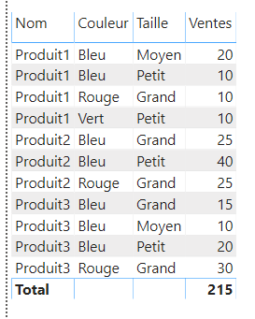
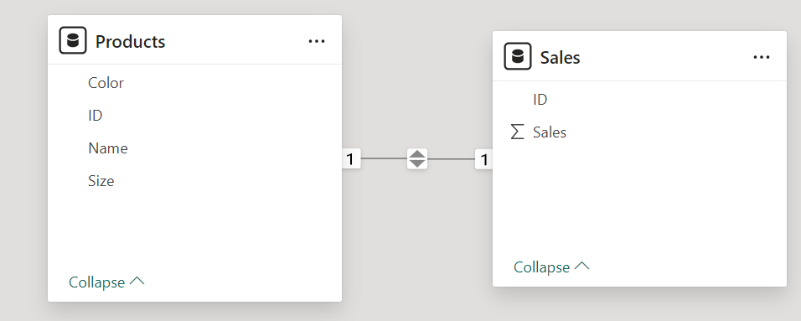
ALL & ALLEXPECT & ALLSELECTED
Add a relationship between the two tables based on the ID column on both sides.
Add a Table visualization to the scene with the product characteristics: Name , Color and Size , with the sum of sales as the aggregation.

Slide 4
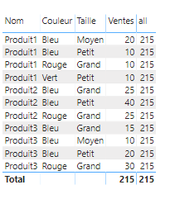
ALL & ALLEXPECT & ALLSELECTED
Add a measure named "all" to the FactProduct table with the formula.
all = CALCULATE ( SUM ( ProductFact [ Sales ] ), ALL ( ProductDim ))
Add the measurement to the visualization.
"all" measure displays the same result as "Total" and removes the filter during the sales sum calculation operation.

Slide 5
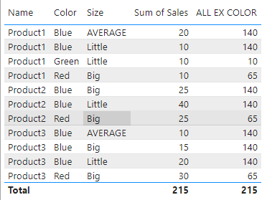
ALL & ALLEXPECT & ALLSELECTED
Create a new measure named "ALL EX COLOR" which cancels the application of the filter except for the color .
ALL EX COLOR = CALCULATE ( SUM ( Sales[Sales] ), ALLEXCEPT ( Products , Products[Color] ))
Blue = 20 + 10 +25 + 40 + 10 +15 + 20
Green = 10
Red = 10 + 25 + 30

Slide 6
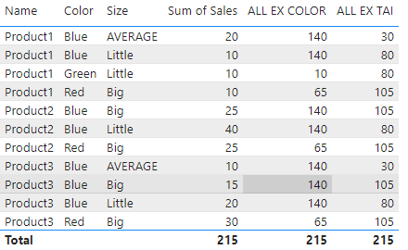
ALL & ALLEXPECT & ALLSELECTED
Create a measure "ALL EX SIZE" which cancels the filter except for the size criterion .
ALL EX SIZE = CALCULATE ( SUM (Sales[Sales]), ALLEXCEPT (Products, Products[Size]))

Slide 7
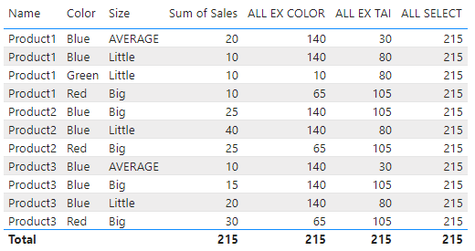
ALL & ALLEXPECT & ALLSELECTED
Add the measure to the visualization instead of "ALL SELECT" and note what cancels the filter on
sum operations , except for the size criterion .​​
ALL SELECT = CALCULATE ( SUM (Sales[Sales]), ALLSELECTED (Products))

Slide 8
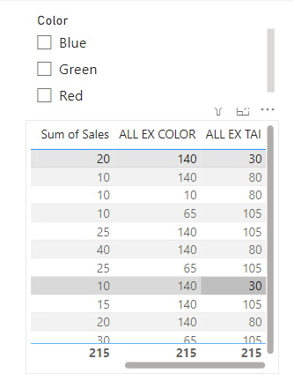
ALL & ALLEXPECT & ALLSELECTED
Add a visualization Slicer to the scene and configure it to list colors .

Slide 9
Thank you
Thank you​

